Slide 1
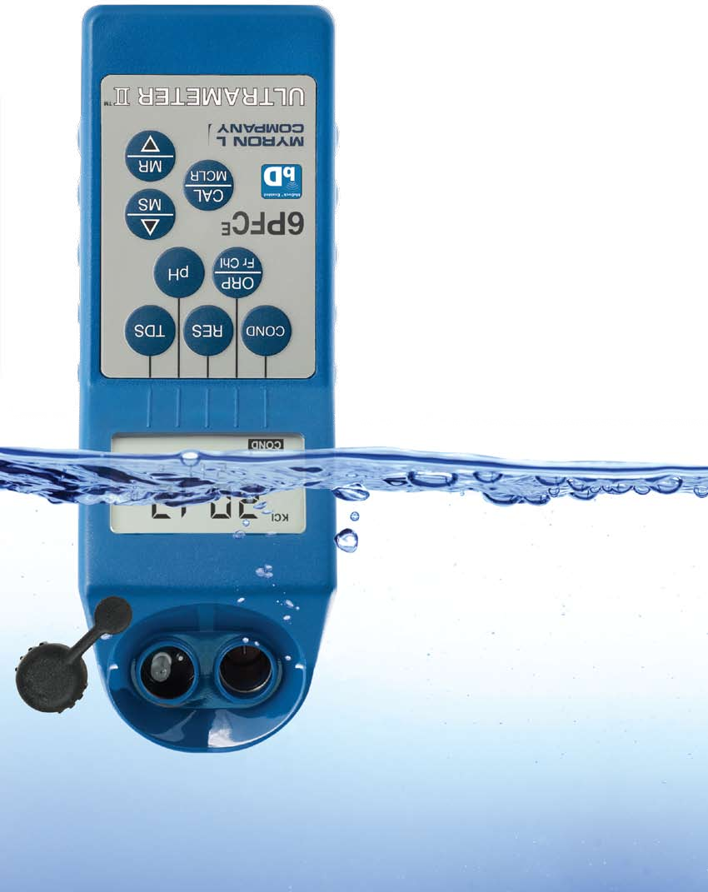

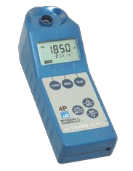






MADE IN USA

Slide 2

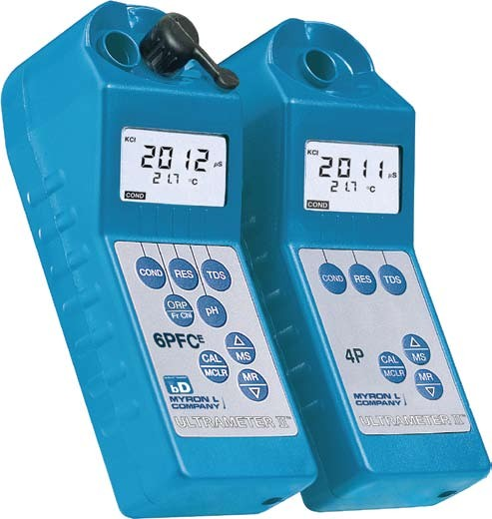

ULTRAMETER
Advanced Design •Superior Performance
Choice of KCl, NaCl, and 442™ Natural Water Standards
ORP mV to ppm free chlorine conversion (6PFCE)
pH/ORP Sensor protective cap (6PFCE)
Four-digit display for full 9999 readings, with autoranging capability up to 200 mS/200 ppt
Powerful microprocessor based surface-mount circuitry
Display prompts for simple pH calibration
Memory for 100 readings with Date & Time Stamp
Real Time Clock Factory calibrations
stored in microprocessor
ULTRA-F AST
bluDockTM Enabled
Both Ultrameter IIs are capable of wireless data transfer with bluDock™ option installed
ULTRA-EASY
ULTRA-POWERFUL
Smanufactured highly reliable analytical instruments Wand monitor/controllers have earned in the past.
ince 1957, the Myron L Company has designed and e are proud of the trust our handheld instruments
for a wide variety of applications. Thousands of professionals around the world rely every day on the performance of our instruments. Demanding uses range from boiler water testing to ultrapure water control to medical instruments for artificial kidney machines.
Our product line has evolved to a new level of outstanding performance and value in analytical instruments: the Ultrameter II series. While priced like affordable single-parameter instruments, the Ultrameter II does
the job of three, four or even six instruments.

Slide 3
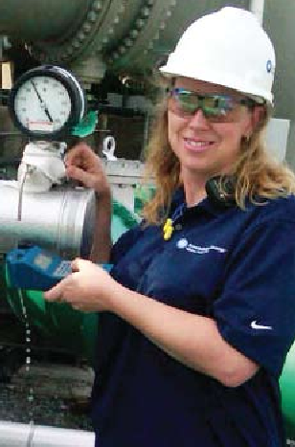

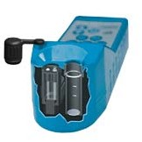
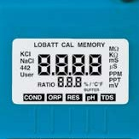
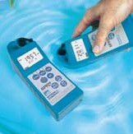
NEW! FCE FAC Function
The Myron L Company FCE function
reports FAC quickly and accurately by measuring ORP, the chemical
3. Take the reading
Temperature compensation and range selection are both rapid and automatic. The Ultrameter II is a true one-hand operation instrument.
Easy to Calibrate
BENEFITS DESIGNED TO SAVE YOU TIME & MONEY
characteristic of directly reflects cross referenced
chlorine that its effectivity, with pH. Both
The 6PFCE measures a dynamic range of free chlorine concentrations wider than the range of colorimetric test kits.
DPD kits and colorimeters may tell the user the FAC value of the sample in the test tube, but since the chemistry of that sample is quite different from the source water being analyzed, the results are imprecisely related to actual disinfection power. The Myron L Company FCE function measures the real, unaltered chemistry of source water, including moment-to- moment changes in that chemistry.
All calibrations are quickly accomplished by pressing the
▲ or ▼ keys to agree with our NIST traceable Standard Solution. When calibration is necessary,
Easily transfer stored readings to Macintosh and PC platforms with the optional bluDock™ accessory package.
display prompts simplify pH calibration and make sure the correct buffer is being used. Plus, all parameters (excluding factory-set temperature) have an internal electronic setting that can be used for field calibration and as a check on pH/ORP sensor life.
Advanced Features
3 solution standards for greatest
accuracy in diverse applications
Fully automatic temperature compensation
User adjustable temperature compensation (up to 9.99%/°C) which also allows TC to be disabled for applications requiring non-compensated readings.
User adjustable conductivity/ TDS conversion ratio for greater accuracy when measuring solutions not contained in the microprocessor.
Auto-shutoff maximizes the life of the single 9V battery to more than 100 hours/5000 tests.
Non-volatile microprocessor provides data back-up, even when the battery is changed. This assures all calibrations and memory data will be retained.
Extended life pH/ORP sensor is user replaceable in the field.
Ample memory provides increased flexibility to record and store 100 separate readings.
Accuracy You Can Trust
Both Ultrameter II models deliver
performance of ±1% of reading (not merely full scale). This high level of accuracy has been achieved through advanced four-electrode conductivity cell technology, a unique pH/ORP sensor and powerful microprocessor-based circuitry. With displayed values of up to 9999, the full four-digit LCD ensures resolution levels never before possible in
Real Time Clock with Date & Time Stamp allows you to maintain the integrity of each individual reading.
The advanced four- electrode cell for conductivity/resistivity/ TDS eliminates polarization, allowing greater accuracy and stability with minimal maintenance.
such affordable instruments. Factory calibrated with NIST traceable solutions, each Ultrameter II may be supplied with both certification of traceability and NIST traceable solutions for definitive calibration.
The pH/ORP sensor chamber provides protection to a unique porous liquid-junction.
Fast and accurate in the laboratory, both Ultrameter II models are rugged enough for
daily in-line controller checks in hostile process applications.
Innovative Engineering
The Ultrameter II is a prime example
of how high-tech engineering can greatly simplify and streamline a task. Whether in the lab, industrial plant, or in a remote field location, merely:
Fill the cell cup
Push a parameter key
The large capacity KCI reservoir guarantees extended life.
A custom LCD helps simplify calibration and operation by using annunciators and prompts to indicate various conditions.
Multiple Applications
Irrigation Water • Hydroponics
Laboratories • Wastewater
Reverse Osmosis • Deionization
Cooling Towers • Environmental
Desalination • Fountain Solutions • Homeland Security
IP67/NEMA 6 rated Ultrameter IIs are waterproof and buoyant and can be fully immersed to
3 feet/1 meter.

Slide 4
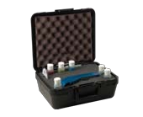
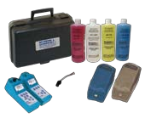
Features
Ultrameter II™ Models | 4PII | 6PFCE
 | Conductivity TDS, Resistivity Temperature | Conductivity TDS, Resistivity, pH ORP, Free Chlorine Temperature
ORP mV and Free Chlorine |  | •
Autoranging | • | •
Adjustable Temp. Compensation | • | •
Adjustable Cond/TDS ratio | • | •
Memory (100 readings) | • | •
Date & Time Stamp | • | •
pH Calibration Prompts |  | •
Low battery indicator | • | •
Auto-off | • | •
Specifications
Display
Dimensions: LxWxH
4 Digit Liquid Crystal Display
Weight
196 x 68 x 64 mm/7.7 x 2.7 x 2.5 inches
Case/conductivity cell material
352 g/12.4 oz.
Cell capacities
VALOX*
pH/ORP: 1,2 ml/0.04 oz. Cond/TDS/Res: 5 ml/0.2 oz.
Power
9V alkaline battery
Battery life
>100 hours (5000 readings)
Operating/storage temperature
0 – 55°C/32 – 132°F
Protection ratings
IP67/NEMA 6
Waterproof to 1 meter/3 feet
Parameters
* ® Sabic Innovative Plastics
Ranges | Conductivity 0–9999µS/cm 10–200mS/cm in 5 autoranges | TDS 0–9999ppm 10–200ppt in 5 autoranges | Resistivity 10KΩ–30MΩ | pH 0–14pH | ORP ±999mV | Free Chlorine 0.00–9.99ppm 350≤ORPmV<725 and 0.0≤pH<9.9 725≤ORPmV<825 and 0.0≤pH<8.9 | Temperature 0–71°C 32–160°F
Resolution | 0.01(<100µS) 0.1(<1000µS) 1.0(<10mS) 0.01(<100mS) 0.1(<200mS) | 0.01(<100ppm) 0.1(<1000ppm) 1.0(<10ppt) 0.01(<100ppt) 0.1(<200ppt) | 0.01(<100KΩ) 0.1(>1MΩ) | ±0.01pH | ±1mV | 0.01ppm | 0.1°C/F
Accuracy | ±1% of reading | ±1% of reading | ±1% of reading | ±0.01 pH* | ±1 mV | <1.00ppm ±0.3ppm* ≥1.00ppm ±0.2ppm | ±0.1°C —
Auto Temperature Compensation | 0–71°C 32–160°F | 0–71°C 32–160°F | 0–71°C 32–160°F | 0–71°C 32–160°F | — | 0–71°C 32–160°F | —
Adjustable Temperature Compensation to 25ºC | 0–9.99%/°C | 0–9.99%/°C | 0–9.99%/°C | — | — | — | —
Conductivity/TDS Ratios Preprogrammed | KCl, 442™**, NaCl | KCI, 442™**, NaCl | — | — | — | — | —
Adjustable Conductivity/TDS Ratio Factor | 0.20–7.99 | 0.20–7.99 | — | — | — | — | —
0.1(<1000KΩ)
*± .2 pH in presence of RF fields ≥ 3V/m and >300MHz
**442 Natural Water Standard™ Myron L Company
Accessories
bluDock™ Accessory Package includes bluDock™, Macintosh/PC application software for downloading data and printed instructions. MODEL: BLUDOCK
Certificates confirming the NIST
NOW AVAILABLE!
ORP SENSOR CALIBRATION SOLUTION
Call for details ...
pH Buffers are necessary to maintain accuracy and for periodic calibration of pH and ORP parameters. Calibration with pH 7 Buffer is especially important. All pH 4, 7, and 10 Buffers are NIST traceable and are available in
Hard protective case (kit) with three buffers (pH 4, 7, and 10), one pH/ORP storage solution, and two standard solutions,
(KCI-7000 and 442-3000).
All bottles are 2 oz/59 ml.
traceability of an Ultrameter II are available (must be specified when placing instrument order). MODEL: MC
Conductivity Standard Solutions are necessary to maintain accuracy and for periodic calibration of conductivity/TDS parameters. All Standard Solutions are NIST traceable for your complete confidence. RECOMMENDED VALUEs: KCl- 7000 (7 mS), 442-3000 (TDS), or
NaCl-14.0 (mS) available in 2 oz/59 ml, 1 qt/1 L, and 1 gal/3,8 L.
2 oz/59 ml, 1 qt/1 L, and 1 gal/3,8 L.
pH Sensor Storage Solution Available in 2 oz/59 ml, 1 qt/1 L, and 1 gal/3,8 L.
MODEL: SS20Z, SSQ and SSG
Certificate of NIST traceability for pH Buffer or Conductivity Standard Solutions are available (must be specified when placing solution order). MODEL: SC
Hard protective case (small)
MODEL: UPP
MODEL: PKUU (Replaces PKU)
Soft protective case is constructed of padded Nylon and features a belt clip for
hands-free mobility. MODELs: UCC (Blue) and UCCDT (Desert Tan)
Replacement pH/ORP sensor user-replaceable, features a unique/porous liquid-junction. MODEL: RPR
ORP Sensor Conditioner Solution
MODEL: ORPCOND
Built on Trust
Founded in 1957, Myron L Company is one of the world’s leading manufacturers of water quality instruments. Because of our policy of continuous product improvement, changes in design and the specifications in this brochure are possible. You have our assurance any changes will be guided by
our product philosophy: Accuracy, Reliability, Simplicity.
Limited Warranty
All Myron L Ultrameter IIs have a Two (2) Year Limited Warranty. The pH/ORP sensors have a Six (6) Month Limited Warranty. Warranty is limited to the repair or replacement of the Ultrameter II only, at our discretion. Myron L Company assumes no other responsibility or liability.

